Slide 1
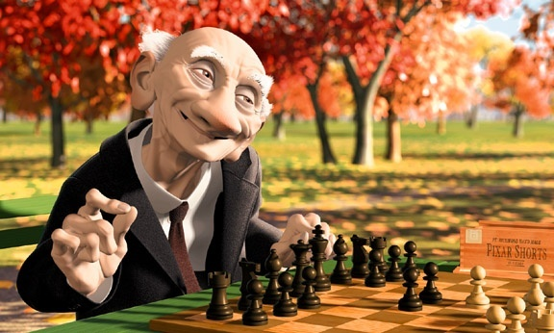
Computer Graphics
Review Points
Instructor: Dr. MAO Aihua
ahmao@scut.edu.cn

Slide 2
CH1: Computer graphics hot topics
CH2: Raster Graphics
CH3: OpenGL basic convections, Coordinate system, Geometric Primitives
CH4: 2D Modeling Transformations, Matrix Representation, Homogeneous Coordinates
CH5: Rendering 3D Scenes Pipeline, 3D Scene Representation, Euclidean Spaces
CH6: Triangle Rasterization, Edge Equations
Notes:
Filament 灯丝
图相管磷涂层被轰击后发光

Slide 3
CH7: Cohen-Sutherland Line Clipping, Cyrus-Beck algorithm
CH8: Basics of Color, Color Spaces
CH9: Light Source , Ambient Light , Surface Reflectance, Phong lighting model
CH10: Global Illumination, Algorithm of ray tracing
CH11: Three shading models, Morphing
Notes:
Filament 灯丝
图相管磷涂层被轰击后发光

